Slide 1
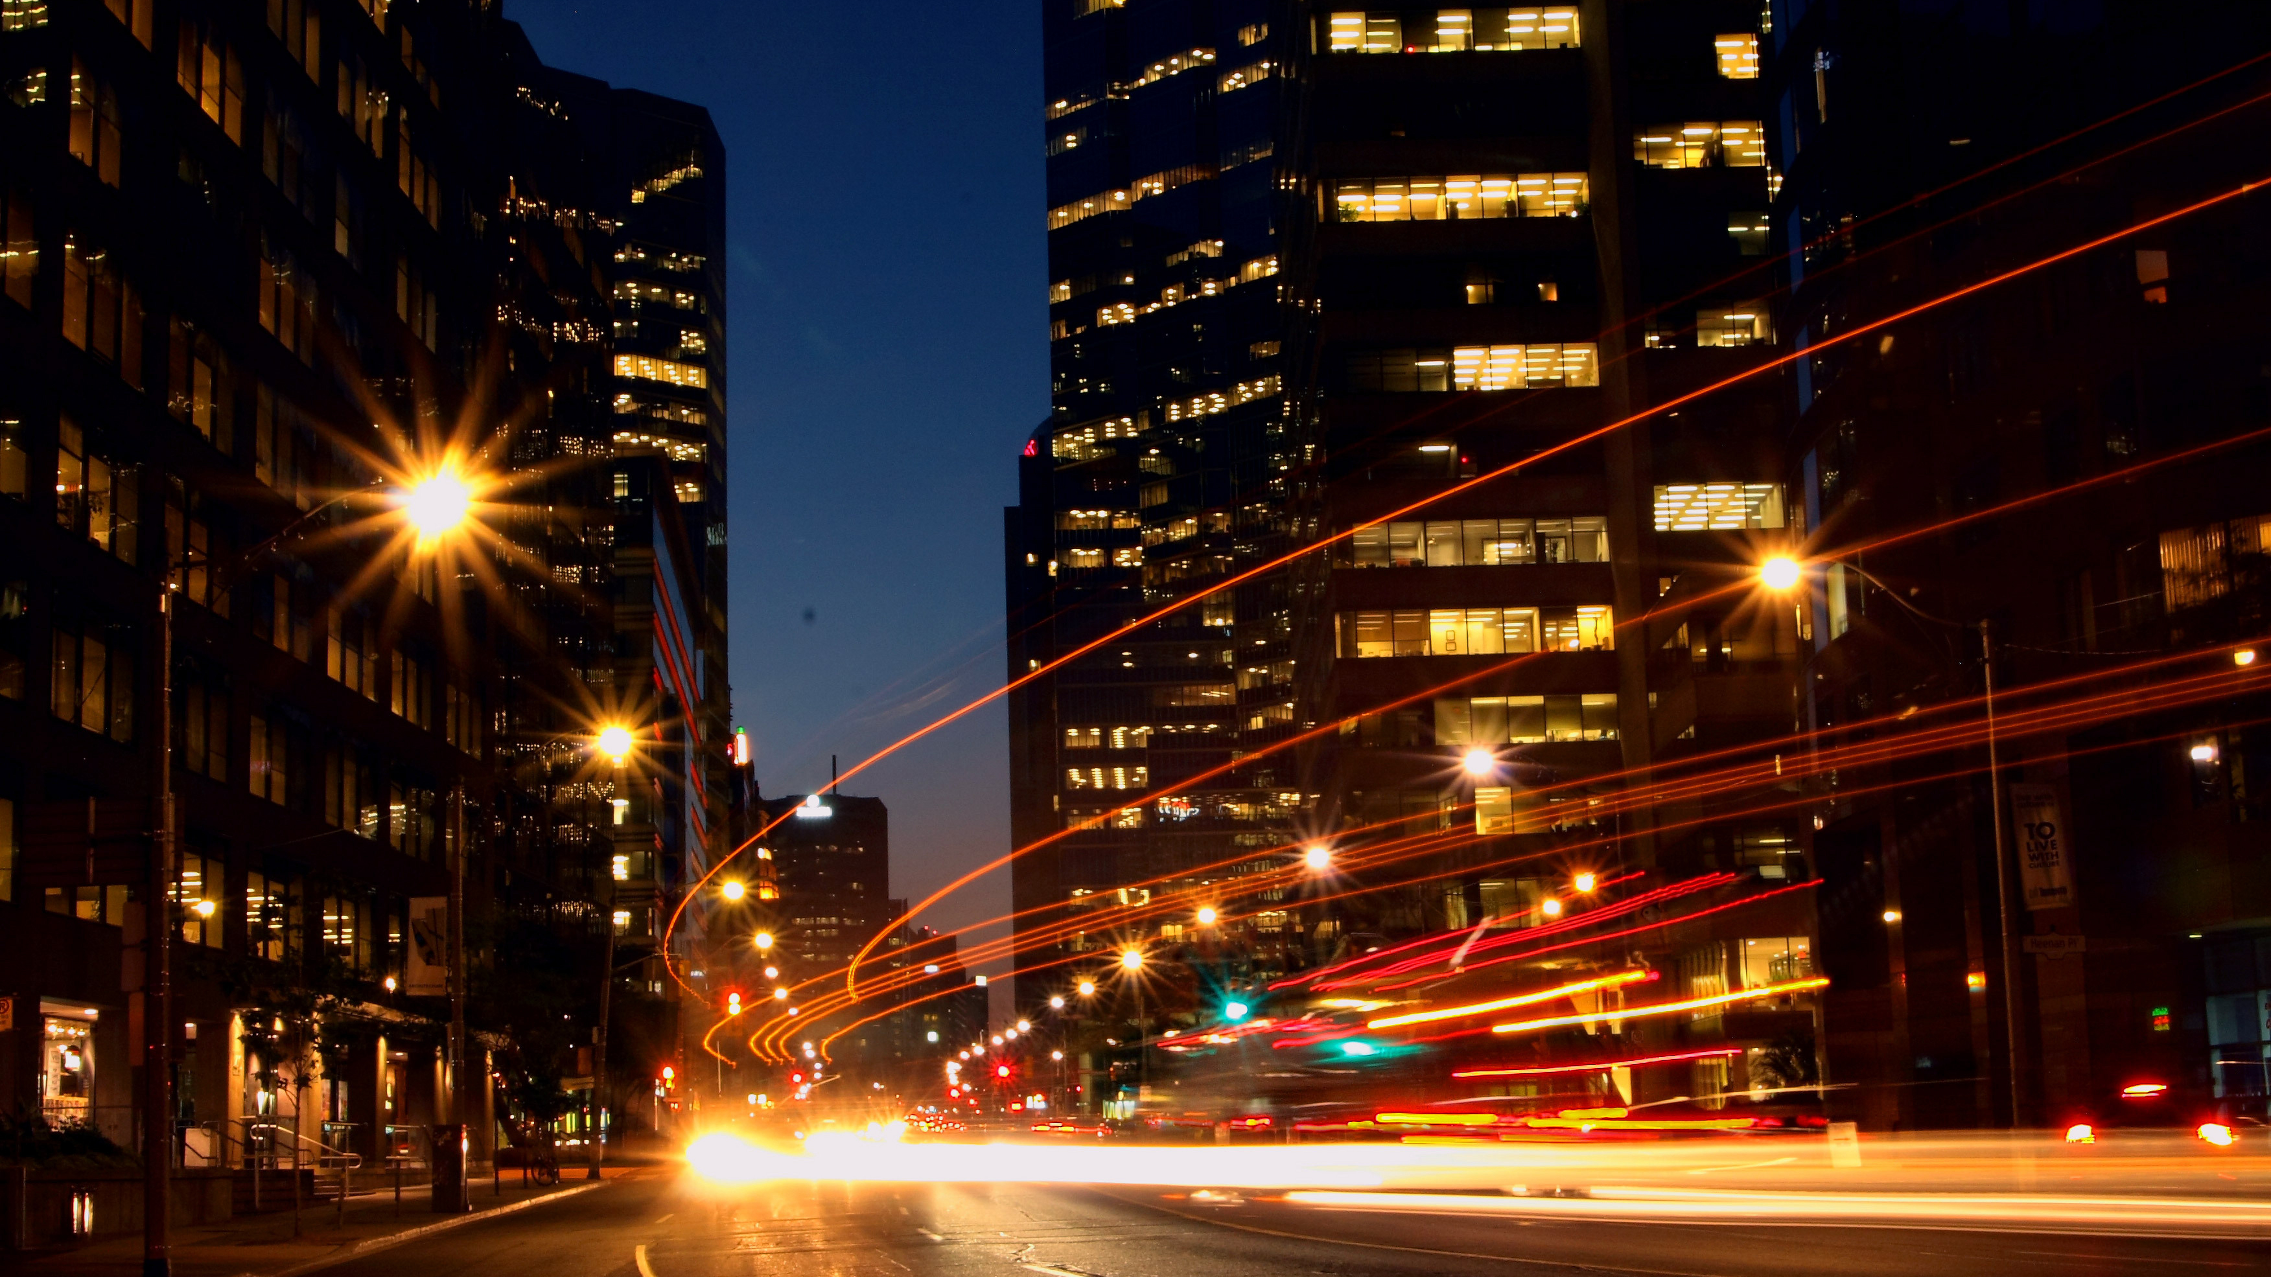

vMeet
MEETING SUMMARIZER
TEAM 9
PRESENTED BY: BHUMIKA, GOWRI SRIKANTH, PATHIK

Slide 2

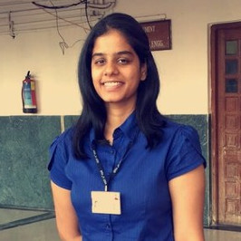

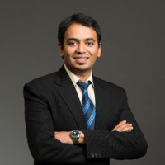
TEAM 9
Meet who are behind the Scenes
Bhumika Patoliya
Gowri Addepalli
Srikanth Kamath
Pathik Jhalavadia
Stevens
NYU
Stevens
Rutgers

Slide 3
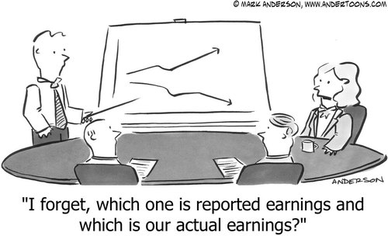

OUR TEAM
MEETINGS IN 2019
MEETINGS ARE FORGOTTEN
These days, every professionals have more than 2 meetings everyday, which means about 10+ meetings in a week. Can you recall all your discussions from last week, last month, last quarter?
MEETINGS CAN BE UNCLEAR
Many people work from home or attend meeting during travel. Sometimes it is not possible to attend the meetings or miss important details due to background noise, divided attention or conflicting priorities.

Slide 4
vMeet
OUR SOLUTION
Meetings for 2020
Identifies Speakers
Converts Speech to Text
Summarizes Overall and Individually
Converts back to Voice and Email

Slide 5

ALGORITHM COMPONENTS
Identifying Speakers
vMeet recognizes you
Once you register your voice, vMeet recognizes you when you enter a meeting

Slide 6




ALGORITHM COMPONENTS
Speech to Text
vMeet transcribes meeting conversations
vMeet listens carefully to what is being discussed. It records the voice and transcribes the voice into text.

Slide 7



ALGORITHM COMPONENTS
Text Summarizing
vMeet knows that you are busy
vMeet does the heavy lifting for you by summarizing whatever was discussed in the meeting so you can keep more important things in mind.

Slide 8

ALGORITHM COMPONENTS
Text to Speech and Summary Email
vMeet has got your back
vMeet will send you the summary as text as well as voice.

Slide 9
Multi Language Support
vMeet is Global
French German
English Spanish
Japanese

